Slide 1
Anomaly Detection in Software Update Streams: Leveraging Machine Learning for Advanced Irregularity Identification
Using AI to identify irregularities in update processes

Slide 2
Agenda Overview
Introduction to Software Update Streams
Defining Anomalies in Software Update Data
Machine Learning Techniques for Anomaly Detection
Advanced Data Analysis Strategies
Implementation and Evaluation of Detection Systems
Notes:
Introduction to Software Update Streams Defining Anomalies in Software Update Data Machine Learning Techniques for Anomaly Detection Advanced Data Analysis Strategies Implementation and Evaluation of Detection Systems

Slide 3
Introduction to Software Update Streams
Notes:
Understanding Software Update Processes, Types of Data Generated in Update Streams, Common Challenges in Managing Update Streams

Slide 4
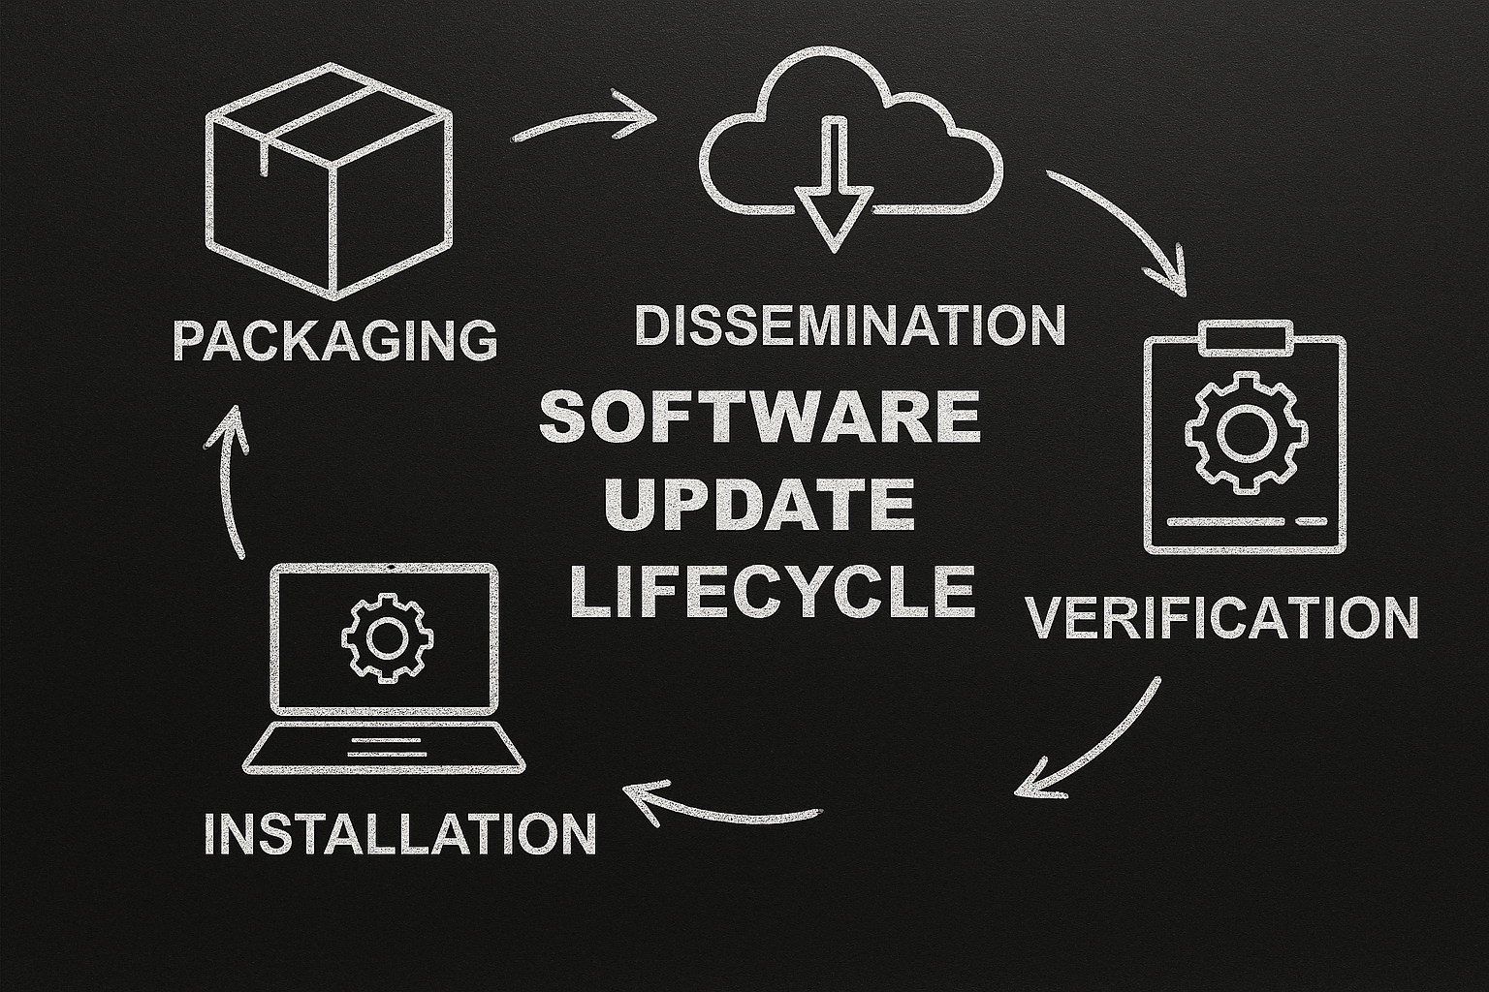
Understanding Software Update Processes
Software Update Stages
Software updates include packaging, dissemination, installation, and verification to ensure system enhancements and security.
Continuous Delivery Models
Modern ecosystems use continuous delivery and deployment to provide frequent, automated software updates.
Update Event Data
Update events capture timestamps, version details, success status, and device identifiers for monitoring.
Anomaly Detection Importance
Understanding update processes helps identify normal versus anomalous behaviors for improved security.
Notes:
--- Software update processes encompass periodic or continuous distribution of software patches, security fixes, and functional enhancements to client systems. These processes involve multiple stages including packaging, dissemination, installation, and verification. Modern software ecosystems increasingly rely on continuous delivery and deployment models, generating complex data streams representing update events that capture timestamps, version metadata, success/failure status, and device identifiers. Understanding these core processes is foundational to identifying normal versus anomalous update behaviors. Image source: AI-generated

Slide 5

Types of Data Generated in Update Streams
Event Logs Data
Event logs include timestamps, version numbers, and error codes generated during system updates.
Performance Metrics
Performance metrics capture download speeds and installation durations reflecting update efficiency.
System States Data
System states data shows hardware and software conditions before and after updates.
Telemetry and User Interaction
Telemetry gathers network conditions and user interaction data to enrich update streams.
Notes:
--- Update streams produce rich data types including event logs (timestamps, version numbers, error codes), performance metrics (download speed, install duration), and system states (pre- and post-update hardware/software conditions). Additionally, telemetry on network conditions and user interactions may be captured. This multidimensional data is time-series in nature and often voluminous, necessitating efficient storage and processing systems. Variability in data types and quality impacts the ability to accurately detect anomalies. Image source: AI-generated

Slide 6

Common Challenges in Managing Update Streams
Data Integrity Challenges
Maintaining data integrity is difficult due to high-volume rapid updates and diverse data formats.
Identifying Irregularities
Detecting subtle anomalies in large continuous streams is complicated by evolving environments causing concept drift.
Timely Anomaly Detection
Balancing timely detection and minimizing false alerts is crucial to maintain system stability.
Notes:
--- Major challenges include maintaining data integrity amidst high-volume rapid updates, handling multi-source heterogeneous data formats, and coping with noise and missing data. Moreover, identifying subtle irregularities in large-scale continuous streams is complex due to evolving software versions and environments inducing concept drift. Ensuring timely anomaly detection without excessive false alerts is critical to minimizing disruptions in update delivery and system stability. Image source: AI-generated

Slide 7
Defining Anomalies in Software Update Data
Notes:
What Constitutes an Anomaly in Update Streams, Examples of Real-World Irregularities, Potential Consequences of Undetected Anomalies An anomaly is any deviation from expected patterns in update metadata, content, or delivery behavior. Common indicators include:
Cryptographic irregularities:
Missing or invalid digital signatures
Hash mismatches between declared and actual file content
Unexpected metadata changes:
Sudden shifts in publisher name or KB identifiers
Unusual file size or version jumps
Behavioral anomalies:
Updates originating from untrusted domains
Irregular timing or frequency of update releases
Examples of Real-World Irregularities
Unsigned binaries in a supposedly secure update package
Tampered manifests where hash values don’t match actual files
Domain reputation issues (updates served from low-trust or compromised servers)
Unexpected payload additions (extra DLLs or executables not documented)
Rapid version changes without corresponding release notes
Potential Consequences of Undetected Anomalies
Security Breaches: Attackers can inject malicious code into updates, leading to supply chain compromises.
Operational Failures: Corrupted or incomplete updates can break critical systems or cause downtime.
Compliance Violations: Failure to detect anomalies may breach regulatory requirements for secure software delivery.
Reputation Damage: Customers lose trust if updates introduce vulnerabilities or instability.

Slide 8

What Constitutes an Anomaly in Update Streams
Definition of Anomalies
Anomalies are data points that significantly deviate from normal update stream behaviors across contexts.
Manifestations of Anomalies
Anomalies may appear as unexpected delays, error spikes, version mismatches, or unusual usage patterns.
Contextual Variations
Anomaly definitions vary by context including statistical outliers, protocol violations, or behavioral inconsistencies.
Distinguishing Noise from Anomalies
It is essential to differentiate true anomalies from noise for effective detection and response.
Notes:
--- Anomalies are data points or patterns in update streams that deviate significantly from established normal behaviors. These may manifest as unexpected delays, abnormal error rates, version inconsistencies, or unusual usage patterns. Definition varies by context—statistical outliers, protocol violations, or behavior inconsistent with historical trends. Clear delineation between noise and true anomalies is essential for effective detection and response. Image source: AI-generated

Slide 9
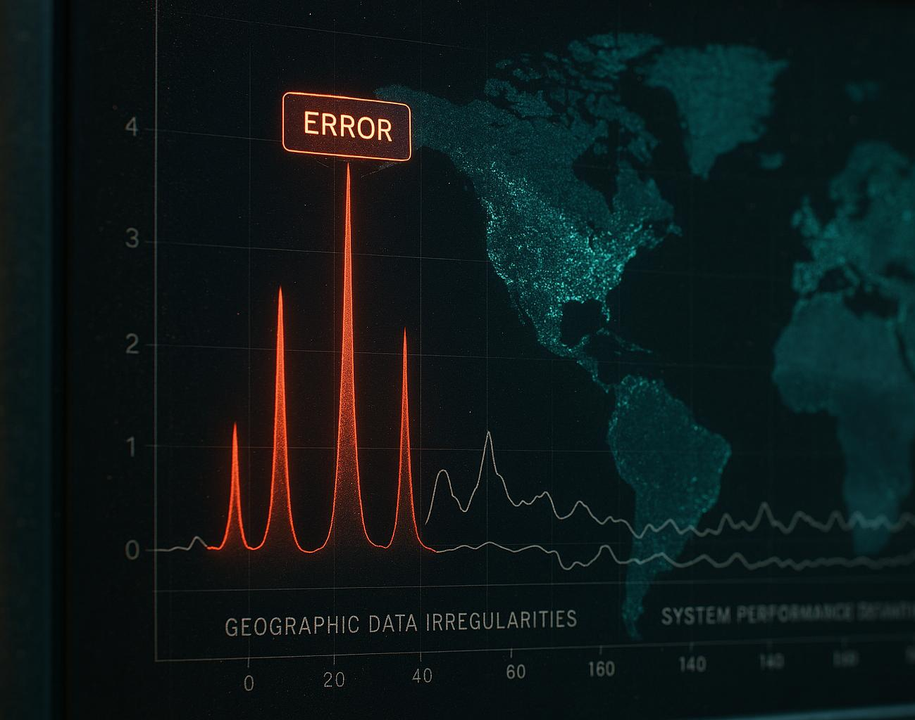
Examples of Real-World Irregularities
Failed Installation Spikes
Sudden increases in failed installations may indicate corrupted update packages disrupting normal process flows.
Version Rollback Events
Occurrences of version rollbacks often signify conflicts during updates, impacting system stability.
Geographical Failure Patterns
Unusual regional patterns of update failures may reflect network issues or targeted cyber attacks.
Performance Deviations
Persistent changes in update durations or resource use can indicate regressions or malware interference.
Notes:
--- Real-world anomalies include sudden spikes in failed installations possibly indicating corrupted update packages, version rollback occurrences signifying update conflicts, and unusual geographical distribution of update failures that may reflect regional network issues or targeted attacks. Additionally, persistent deviations in update durations or resource consumption can indicate performance regressions or malware interference. Image source: AI-generated

Slide 10

Potential Consequences of Undetected Anomalies
System Instability Risks
Undetected anomalies can cause faulty software deployments that destabilize systems and degrade performance.
Security Vulnerabilities
Anomalies left unnoticed create security gaps, increasing the risk of breaches and data loss.
Cascading Failures
Irregularities can propagate through connected systems, leading to widespread failures across networks.
Extended Downtime and Damage
Delayed anomaly detection hampers incident response, prolonging downtime and damaging reputation.
Notes:
--- Failing to detect anomalies in update streams can result in widespread deployment of faulty software leading to system instability, security vulnerabilities, degraded user experience, and financial losses. Undetected irregularities can propagate through interconnected systems causing cascading failures. Moreover, lack of early identification impairs incident response and remedial action, extending downtime and reputational damage. Image source: AI-generated

Slide 11
Machine Learning Techniques for Anomaly Detection
Notes:
Overview of Supervised Vs. Unsupervised Approaches, Popular Algorithms: Isolation Forest, Autoencoders, and Clustering Methods, Feature Engineering and Data Preprocessing for Update Streams

Slide 12
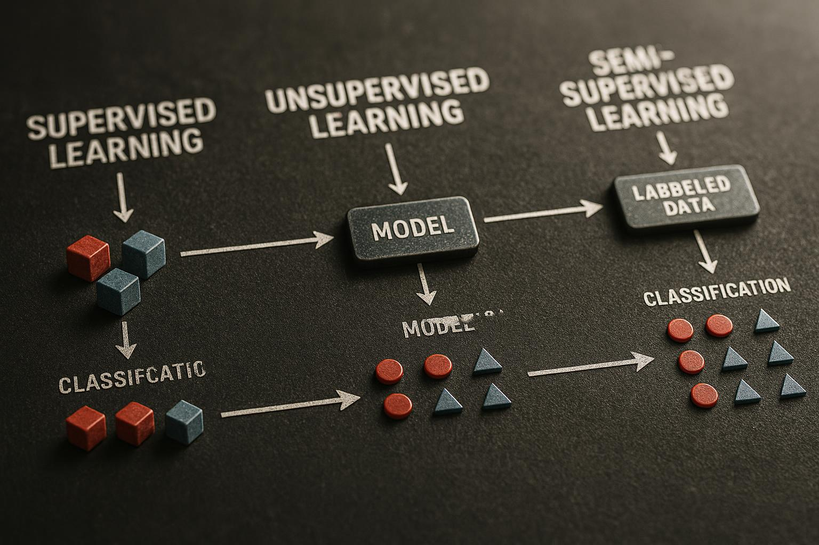
Overview of Supervised Vs. Unsupervised Approaches
Supervised Learning
Uses labeled datasets to classify normal and anomalous states, requiring extensive and costly labeled data.
Unsupervised Learning
Operates without labels by modeling normal behavior to detect anomalies, useful for novel anomaly discovery.
Semi-Supervised Learning
Combines limited labeled data with abundant unlabeled data to improve detection accuracy.
Notes:
--- Supervised learning requires labeled datasets indicating normal and anomalous states, enabling models to classify future samples effectively but demands extensive labeled data that may be scarce or costly. Unsupervised techniques operate without labels by modeling normal behavior and identifying deviations, making them suitable for novel anomaly discovery in evolving environments. Semi-supervised methods combine both to leverage limited labels and abundant unlabeled data for improved accuracy. Image source: AI-generated

Slide 13

Popular Algorithms: Isolation Forest, Autoencoders, and Clustering Methods
Isolation Forest Algorithm
Isolation Forest detects anomalies by randomly partitioning data efficiently, working well on high-dimensional datasets.
Autoencoders for Detection
Autoencoders use deep neural networks to reconstruct inputs and identify anomalies via reconstruction error deviations.
Clustering-Based Methods
Clustering methods find outliers by locating data points distant from cluster centers or forming isolated small clusters.
Notes:
--- Isolation Forest isolates anomalies through random partitioning and is effective for high-dimensional data with linear time complexity. Autoencoders, deep neural networks trained to reconstruct inputs, detect anomalies by reconstruction error deviations. Clustering-based methods identify outliers by measuring data points far from cluster centroids or small isolated clusters. Each algorithm offers tradeoffs in interpretability, computational cost, and detection sensitivity relevant to update stream characteristics. Image source: AI-generated

Slide 14
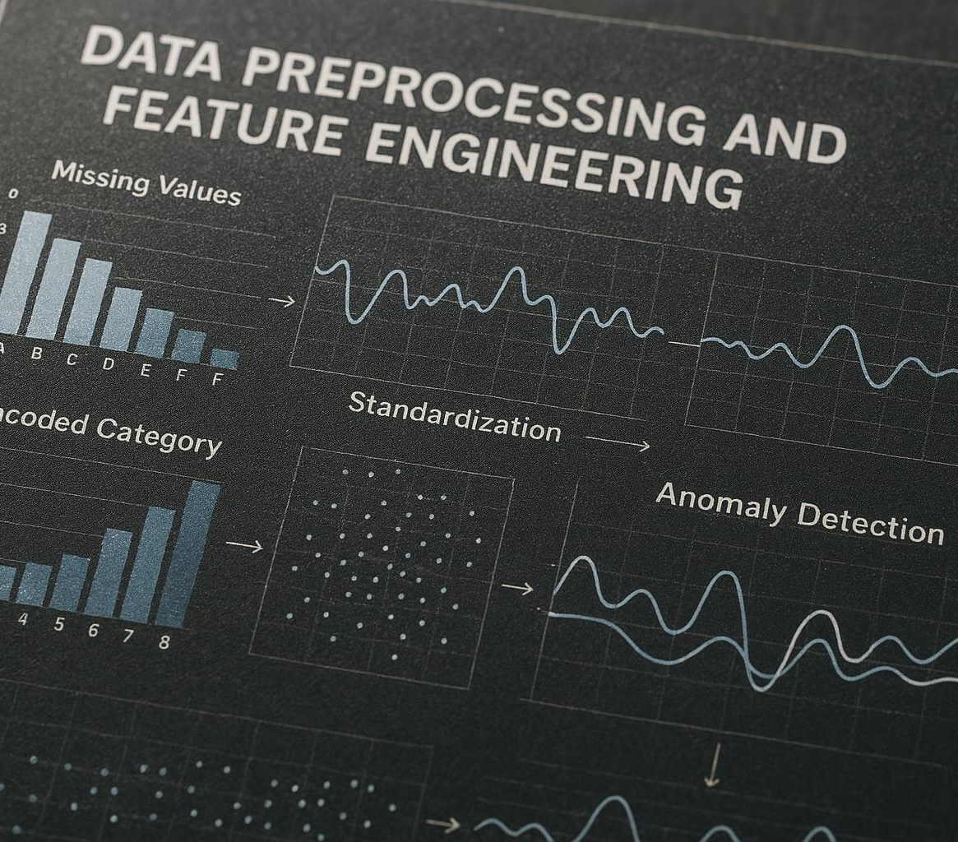
Feature Engineering and Data Preprocessing for Update Streams
Informative Feature Extraction
Extract key features like update intervals, success ratios, error codes, and resource usage for anomaly detection.
Data Preprocessing Steps
Handle missing data, normalize values, encode categorical variables, and apply temporal smoothing effectively.
Dimensionality Reduction
Use feature selection and reduction techniques to reduce dimensionality and improve algorithm performance.
Notes:
--- Quality anomaly detection critically depends on extracting informative features such as time intervals between updates, success ratios, error code distributions, and resource usage statistics. Preprocessing steps include handling missing data, normalization, encoding categorical variables, and temporal smoothing. Feature selection and dimensionality reduction techniques help mitigate the curse of dimensionality and improve algorithm performance on high-velocity update stream data. Image source: AI-generated

Slide 15
Advanced Data Analysis Strategies
Notes:
Time-Series Analysis and Monitoring, Use of Statistical Models and Thresholds, Integration of Domain Knowledge Into Anomaly Detection

Slide 16

Time-Series Analysis and Monitoring
Time-Series Analysis Techniques
Methods such as ARIMA, seasonal decomposition, and sliding window models capture temporal dependencies and seasonal patterns effectively.
Continuous Monitoring
Adaptive thresholds enable real-time detection of anomalies by monitoring deviations from expected update behaviors.
Visualization Dashboards
Dashboards visualize temporal trends clearly to support investigations and preventive actions.
Notes:
--- Time-series analysis techniques like ARIMA, seasonal decomposition, and sliding window models help capture temporal dependencies and seasonal update patterns. Continuous monitoring with adaptive thresholds permits real-time detection of deviations from expected update behaviors. Visualization dashboards can illustrate temporal trends to aid directed investigations and preventive measures. Image source: AI-generated

Slide 17

Use of Statistical Models and Thresholds
Normative Behavior Distributions
Statistical models define expected behavior patterns to identify anomalies beyond confidence intervals.
Dynamic Threshold Techniques
Methods like z-score and moving averages set dynamic thresholds to detect significant data deviations.
Calibration for Detection Accuracy
Balancing sensitivity and false positives optimizes anomaly detection in noisy datasets.
Notes:
--- Statistical models establish normative behavior distributions enabling detection of anomalies beyond confidence intervals. Techniques such as z-score, moving averages, and probabilistic models define dynamic thresholds to distinguish significant deviations. Proper calibration balances sensitivity and false positives to optimize detection efficacy in noisy update data. Image source: AI-generated

Slide 18

Integration of Domain Knowledge Into Anomaly Detection
Contextualizing Anomalies with Expert Knowledge
Expert knowledge on software policies helps contextualize anomalies and prioritize high-risk events effectively.
Hybrid Detection Systems
Combining automated detection with rule-based filters enhances detection precision and reduces false positives.
Informed Feature Engineering
Domain knowledge guides feature engineering and interpretation of anomalies for effective operational responses.
Notes:
--- Incorporating expert knowledge on software versioning policies, update protocols, and common failure modes enhances detection by contextualizing anomalies and prioritizing high-risk events. Hybrid systems combining automated detection with rule-based filters improve precision. Domain knowledge also informs feature engineering and the interpretation of detected anomalies for effective operational response. Image source: AI-generated

Slide 19
Implementation and Evaluation of Detection Systems
Notes:
Building a Machine Learning Pipeline for Anomaly Detection, Validation Metrics and Performance Evaluation, Case Studies and Lessons Learned

Slide 20

Building a Machine Learning Pipeline for Anomaly Detection
Pipeline Components
Includes data ingestion, preprocessing, feature extraction, model training, anomaly scoring, and alert generation steps.
Design Considerations
Automation, scalability, and fault tolerance are essential for reliable production deployment.
Continuous Improvement
Feedback integration and retraining help handle evolving update patterns and concept drift effectively.
Notes:
--- An end-to-end pipeline includes data ingestion from update streams, preprocessing, feature extraction, model training or updating, anomaly scoring, and alert generation. Automation, scalability, and fault tolerance are critical design factors for production deployment. Continuous integration of feedback and retraining addresses evolving update patterns and concept drift. Image source: AI-generated

Slide 21
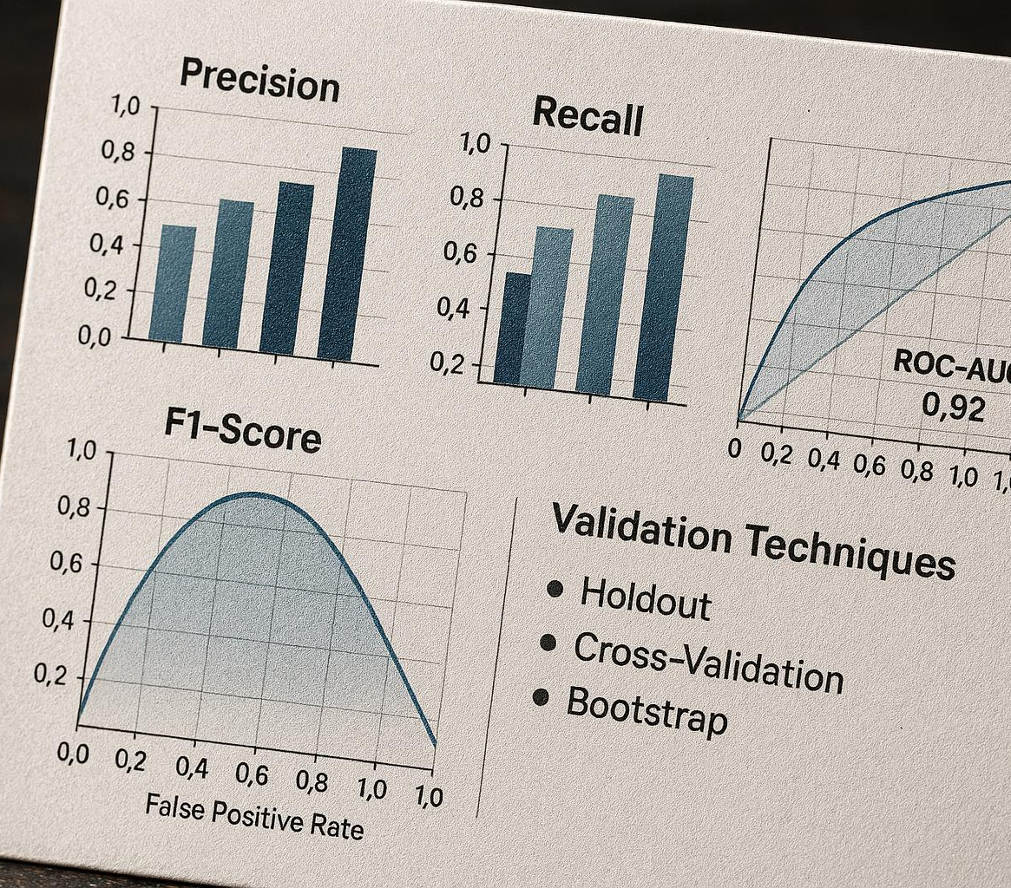
Validation Metrics and Performance Evaluation
Key Evaluation Metrics
Precision, recall, F1-score, ROC-AUC, and confusion matrices are standard metrics used to assess detection quality effectively.
Focus on Minority Classes
In imbalanced anomaly datasets, metrics like recall and F1-score highlight the detection of minority classes for better accuracy.
Robustness Through Validation
Cross-validation, temporal splits, and real-world testing help ensure model robustness and generalization across scenarios.
Notes:
--- Standard metrics such as precision, recall, F1-score, ROC-AUC, and confusion matrices assess detection quality. For imbalanced anomaly datasets, metrics that emphasize minority class detection (e.g., recall and F1) are prioritized. Cross-validation, temporal validation splits, and real-world testing ensure robustness and generalization of detection systems. Image source: AI-generated

Slide 22

Case Studies and Lessons Learned
Domain-Specific Customization
Tailoring models to specific domains enhances performance by addressing unique challenges and reducing errors.
Detection Speed vs Accuracy
Balancing rapid detection with accuracy is crucial for effective real-world deployments and user trust.
Human-in-the-Loop Feedback
Integrating human feedback improves system adaptability and helps manage false alarm rates.
Adaptive Monitoring and Models
Continuous monitoring and adaptive models are essential in dynamic, evolving software environments.
Notes:
--- Case studies reveal practical insights such as the importance of domain-specific customization, handling concept drift, and managing false alarm rates. Real deployments highlight tradeoffs between detection speed and accuracy and underscore the value of integrating human-in-the-loop feedback. Lessons learned also emphasize the need for comprehensive monitoring and adaptive models in dynamic software update environments. Image source: AI-generated

Slide 23
Conclusion: Harnessing Machine Learning to Secure Software Update Streams
An anomaly is any deviation from expected patterns in update metadata, content, or delivery behavior. Common indicators include:
Cryptographic irregularities:
Missing or invalid digital signatures
Hash mismatches between declared and actual file content
Unexpected metadata changes:
Sudden shifts in publisher name or KB identifiers
Unusual file size or version jumps
Behavioral anomalies:
Updates originating from untrusted domains
Irregular timing or frequency of update releases
Examples of Real-World Irregularities
Unsigned binaries in a supposedly secure update package
Tampered manifests where hash values don’t match actual files
Domain reputation issues (updates served from low-trust or compromised servers)
Unexpected payload additions (extra DLLs or executables not documented)
Rapid version changes without corresponding release notes
Potential Consequences of Undetected Anomalies
Security Breaches: Attackers can inject malicious code into updates, leading to supply chain compromises.
Operational Failures: Corrupted or incomplete updates can break critical systems or cause downtime.
Compliance Violations: Failure to detect anomalies may breach regulatory requirements for secure software delivery.
Reputation Damage: Customers lose trust if updates introduce vulnerabilities or instability.
Notes:
In summary, this presentation highlighted the complexities of software update streams and the critical role of detecting anomalies within them. By leveraging machine learning techniques alongside advanced data analysis and domain knowledge, we can build robust systems that identify irregularities early, protecting software integrity and reliability. Continuous evaluation and adaptation of these detection systems are essential for maintaining security in evolving environments. What Constitutes an Anomaly in Update Streams, Examples of Real-World Irregularities, Potential Consequences of Undetected Anomalies An anomaly is any deviation from expected patterns in update metadata, content, or delivery behavior. Common indicators include:
Cryptographic irregularities:
Missing or invalid digital signatures
Hash mismatches between declared and actual file content
Unexpected metadata changes:
Sudden shifts in publisher name or KB identifiers
Unusual file size or version jumps
Behavioral anomalies:
Updates originating from untrusted domains
Irregular timing or frequency of update releases
Examples of Real-World Irregularities
Unsigned binaries in a supposedly secure update package
Tampered manifests where hash values don’t match actual files
Domain reputation issues (updates served from low-trust or compromised servers)
Unexpected payload additions (extra DLLs or executables not documented)
Rapid version changes without corresponding release notes
Potential Consequences of Undetected Anomalies
Security Breaches: Attackers can inject malicious code into updates, leading to supply chain compromises.
Operational Failures: Corrupted or incomplete updates can break critical systems or cause downtime.
Compliance Violations: Failure to detect anomalies may breach regulatory requirements for secure software delivery.
Reputation Damage: Customers lose trust if updates introduce vulnerabilities or instability.

Slide 24
Conclusion: Harnessing Machine Learning to Secure Software Update Streams
Complexities of Software Updates
Software update streams involve intricate data flows that require careful monitoring for security and reliability.
Machine Learning Anomaly Detection
Machine learning techniques enable early detection of irregularities in software update streams, enhancing security.
Continuous Evaluation and Adaptation
Ongoing assessment and improvement of detection systems ensure protection against evolving security threats.
Notes:
In summary, this presentation highlighted the complexities of software update streams and the critical role of detecting anomalies within them. By leveraging machine learning techniques alongside advanced data analysis and domain knowledge, we can build robust systems that identify irregularities early, protecting software integrity and reliability. Continuous evaluation and adaptation of these detection systems are essential for maintaining security in evolving environments.

Slide 25
Thank you! Any Questions?

Slide 26
References
Anomaly Detection Tasks - https://learn.microsoft.com/dotnet/machine-learning/resources/tasks#anomaly-detection
ML.NET documentation - ML.NET documentation - Tutorials, API reference | Microsoft Learn
Notes:
In summary, this presentation highlighted the complexities of software update streams and the critical role of detecting anomalies within them. By leveraging machine learning techniques alongside advanced data analysis and domain knowledge, we can build robust systems that identify irregularities early, protecting software integrity and reliability. Continuous evaluation and adaptation of these detection systems are essential for maintaining security in evolving environments.

